Slide 1
BHI EDW Modernization POC
6-Week POC Scope Discussion
Notes:
Please email me the code

Slide 2
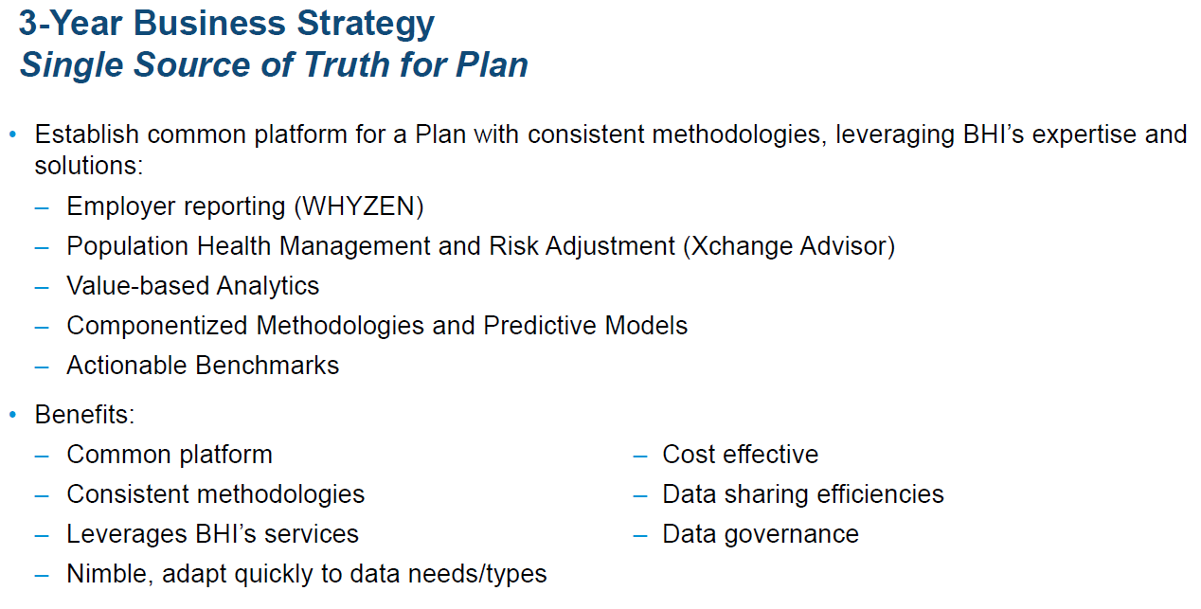
BHI Vision: Single Source of Truth

Slide 3
Core Value Drivers for BHI
Ability to develop new capabilities that increase the value of BHI’s products
Time to market and cost
Leveraging an agile product development approach
Onboarding of new clients
Time to execution
Flexibility to integrate
Efficient Operations
Throughput
Efficiency and cost for carrying out
Scalability

Slide 4
Solution Focus
Referred to as Data Staging Area
Inputs
Client Specific Data
Data Layer
Member
Provider
Claims (Medical, Dental, Other)
BDSC, BDTC
Flex Network
Data Processing/ Enrichment Layer
Claims Categorizations
Quality Metrics
Episode Grouper
Health Status
Predictive Analytics
Risk Scores
Reporting Layer
Development Activities →
Whyzen Analytics
Consultyng and Informatics
Population Advyzer
Trend Insyghts
Provider Analytics
Agent Reporting
Benchmarking
Care Management

Slide 5
The Data Vault Solution
Data Vault’s unique attributes enable a Business Object Model-driven approach for automating the data transformation process.
1
If the data inflow does not change, these steps have to be performed ONLY ONCE
The Innovator Warehouse Edition provides a set of Add-ons that help to automate first time generation as well as the maintenance of a large scale Data Vault instance
The extension provides a high level of efficiency, accuracy and lead-time advantage
These steps will be performed on premise, whereas the data processing can be done in the Cloud
The Innovator models provide a clean and readable documentation of all data formats and transformations
Build a Business Object Model in Entity Relationship Notation in Innovator
Business Object Model
4
2
Define hard business rules
Innovator automates generation of Raw Vault Model from Business Object Model
Landing Zone
Staging
Raw Vault
Business Vault
Raw Mart
Customer
Information Marts
Customer
Customer
Client Plan Data
3
5
6
7
Use Innovator to generate Staging using Landing Zone tables
Map Staging to Raw Vault in Innovator using semi-automated plugins
Model the transformations (Soft Rules) in specialized BPMN and ER
Generate views from Raw & Business Vaults
Data Set
Notes:
Importance of metadata

Slide 6
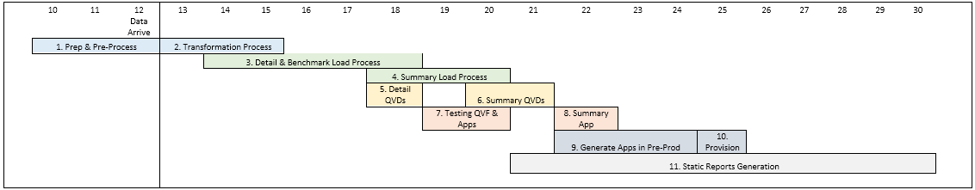
There a 2 disctint processes, we need to be aware of
whYzen Monthly Intake Process
New Client Onboarding Process
Analysis & Discovery
Analysis & Design
Design
Production
Discovery

Slide 7
BHI Goals (1/3)
Improved throughput of Monthly Intake Process enabled by
Increases opportunities for parallel processing
Hashkeys allow loading of each table (hub, link or satellite) independent of each other
Greater opportunities to benefit from massive parallel processing
Deferred error correction decreases ingestion cycle times
Data is loaded as-is
Soft business rules deferred to later in data transformation process
In case of fatal errors: only a portion of the data and a portion of the process needs to be rerun

Slide 8
BHI Goals (2/3)
Faster onboarding of new clients and development of new products
Automation
Metadata creates the code for integration, historisation, and standard quality checks
Resources are free for complex transformation and data enhancement
Loosely coupled Hub-Link-Satellite data model (better wording)
Enables incremental development
Complete first loading faster (increment)
Generate quicker feedback in the target reporting environment
Solve problems more quickly

Slide 9
BHI Goals (3/3)
Faster onboarding through more effective and more efficient communication
Common Business Object Model allows BHI to facilitate a quicker, more efficient communication
Facilitating conversations with Clients about BHI will be mapping their data to the Common Business Object Model
Common Language create a better understanding
Facilitates quicker, more efficient analysis and design of the data transformation and integration processes within BHI
Facilitates quicker, more efficient communication and design of the data analytics
Because these discussions are refocused/recast around Common Business Objects
…not data files, complex SQL tables, SAS artifacts, etc.

Slide 10
Different Business Object Models in use at BHI

Slide 11
Common Business Object Model (Proposed)

Slide 12
Common Business Object Model (BHI Goal #3)
Don’t under estimate the importance of
The ability to engage in discussions with a new client (a Blue) and use the Common Business Object Model as the single lingua franca for data across all of BHI’s product lines and services
Example
Data mapping discussions evolve more easily: “Client has X in their data and we can now see how it might map to a BHI business object”
Employer, Subscriber, Member, different Claim types, etc.
lingua franca = a language that is adopted as a common language between speakers whose native languages are different.

Slide 13
Example of a New Client Onboarding Process
Explain Business Object Model to Client
BHI works with Client to define data mappings to the Common Business Object Model
Select 2-3 Business Objects and start loading a subset of the data
Show the client his first data after a short time (e.g. 2 Weeks)
Select additional Business objects & load more of required data
Get client feedback for the original data load
Make corrections and continue loading more data
Get client feedback for the second data load
...

Slide 14
POC Scope Discussion
POC Dimensions

Slide 15
POC Scope Dimensions
The following dimensions control the scope of the POC:
Common Business Objects: which objects are needed by analysis
Plan(s): E.g. Michigan, Wyoming, …
Plan Sources
E.g. Michigan BCN, Michigan BCBSM, Michigan BCBSMA
Source Data
E.g. Michigan’s 3 sources consist of 17 source flat files
Member/Medical, Company, Pharmacy
Choice dependent on Common Business Object requirements
Dimensions and Measures for Analysis

Slide 16
POC Scope (1/2)
Actual dimension choices recommended for the 6-week POC:
Common Business Objects
Insurance Buyer, Contract, Subscriber, Member and Pharmacy
Plan(s): Michigan
Plan Sources: Michigan BCN, BCBSM & BCBSMA (3)
Source Data: 13 of 17 Michigan source flat files
Member/Medical, Company, Pharmacy (No Visual or Dental source files)
All records but only selected attributes
Attributes selected based on requirements of the Dimensions and Measures

Slide 17
POC Scope (2/2)
Dimensions (not final)
Measures (not final)

Slide 18
POC Processing
POC will demonstrate end-to-end process
SQL Server platform (single server)
13 source flat files ingested into Landing Zone and Staging tables
Data transformed into Raw Vault (H-L-S architecture)
Based on/derived directly from the Common Business Object Model
Dimensions and Measures realized as Excel spreadsheets
Exported from SQL Views that run against the Raw Vault and Business Vault

Slide 19
Sprint Strategy
Three (3) 2-week sprints
Week 1-2: Member/Medical
Week 3-4: Company
Week 5-6: Pharmacy

Slide 20
Issues and Concerns (1/2)
To be able to estimate of throughput, we need a better understanding of the current Monthly Intake Process
To produce correct measures, we need a better understanding of how they are calculated
To decide on the detailed Data Vault architecture, we need a better understanding of how diverse the plan data varies from one Plan to the next
Depending on the diversity of the plan data, the Data Vault architecture may require the addition of a Source Vault
Additional storage and processing capability

Slide 21
Data Vault Conceptual Architecture for BHI

Slide 22
Issues and Concerns (2/2)
Difficulty extracting soft business rules from the SAS scripts
Mitigation: MID Innovator partner has a technology for mining SAS logs and automatically generating BPMN diagrams that visualize the processing represented by the SAS script

Slide 23
Questions?

Slide 24
Backup Slides

Slide 25
BHI Landscape: Current State (2017)

Slide 26
BHI Landscape: Future State (2018++)

Slide 27
BHI Landscape: Product Lines

